Slide 1


Slide 2


Slide 3


Slide 4
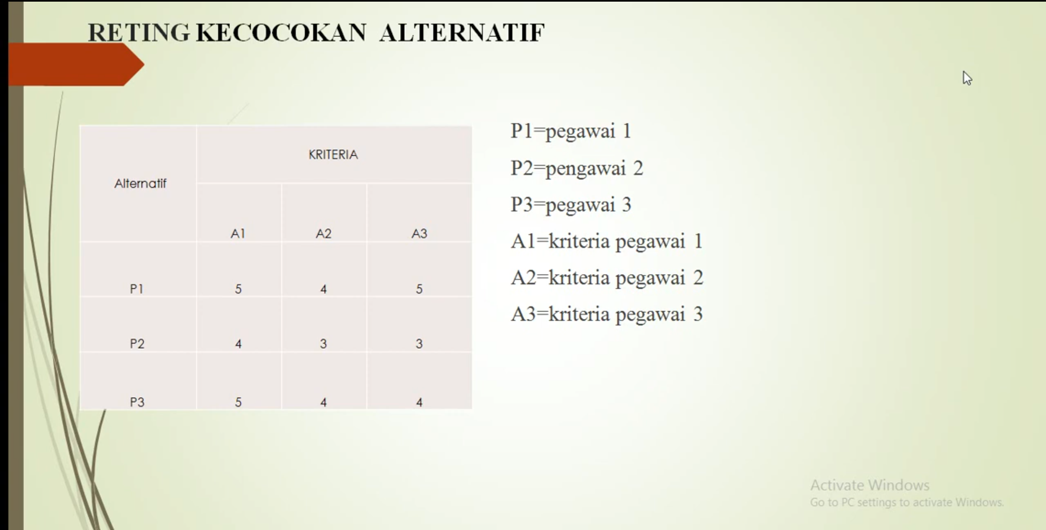

Slide 5
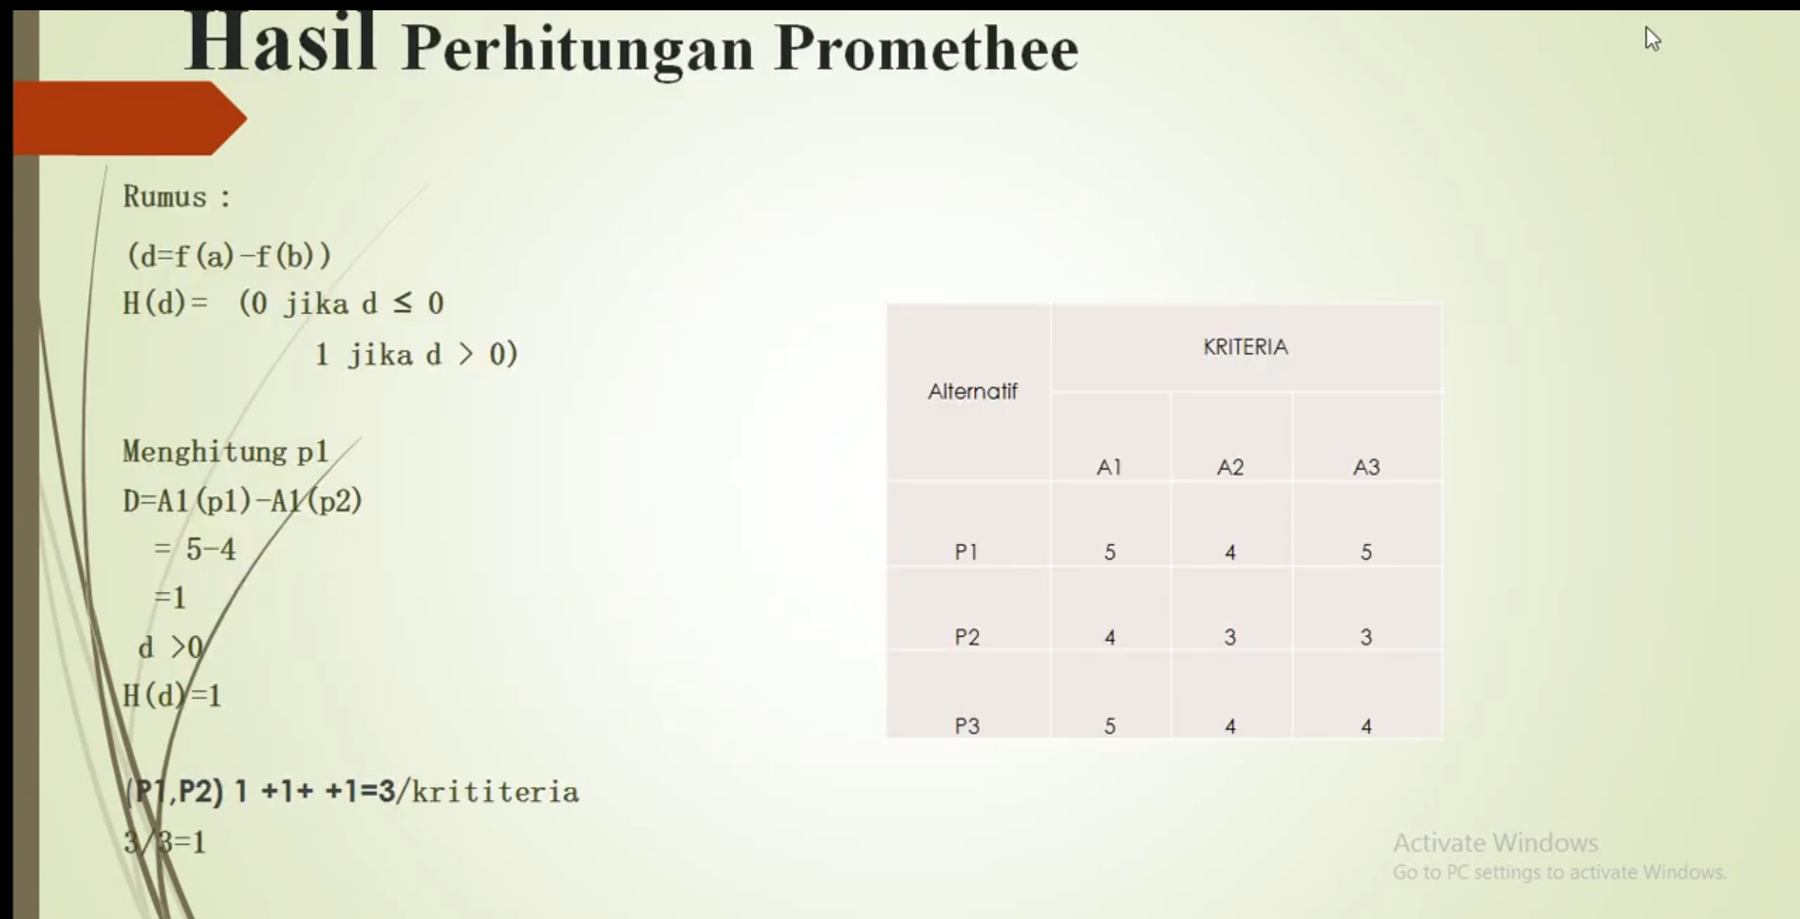

Slide 6
MENENTUKAN KENAIKAN JABATAN
1
ALTERNATIF | KRITERIA
 | A1 | A2 | A3
P1 | 5 | 4 | 5
P2 | 4 | 3 | 3
P3 | 5 | 4 | 4
3. Nilai dari pengurangan kriteria dikonversi jika nilainya minus jadi 0
Ket:
P1: Pegawai 1
P2: Pegawai 2
P3: Pegawai 3
3
DIKONFERSI |  |  | HASIL
A1 | A2 | A3
1 | 1 | 1 | 1
0 | 0 | 1 | 0.333333
0 | 0 | 0 | 0
0 | 0 | 0 | 0
0 | 0 | 0 | 0
1 | 1 | 1 | 1
4
INDIKATOR PREFENSI MULTI KRITERIA DARI HASIL
ALTERNATIF | KRITERIA
 | A1 | A2 | A3
P1 |  | 1 | 0.333333
P2 | 0 |  | 0
P3 | 0 | 1
JUMLAH | 0 | 2 | 0.333333
2
f(x, y) = x-y | A1 | A2 | A3
(P1, P2) | 1 | 1 | 2
(P1, P3) | 0 | 0 | 1
(P2, P1) | -1 | -1 | -2
(P2, P3) | -1 | -1 | -1
(P3, P1) | 0 | 0 | -1
(P3, P2) | 1 | 1 | 1
5
MENENTUKAN NILAI LEAVING FLOW, ENTERING FLOW, NET FLOW
LEAFING FLOW
P1 | 0.666667
P2 | 0
P3 | 0.5
ENTRING FLOW
P1 | 0
P2 | 4
P3 | 0.166667
NET FLOW
P1 | 0.666667
P2 | -4
P3 | 0.333333
6
NILAI LEAVING FLOW, ENTERING FLOW, NET FLOW
ALTERNATIF | LEAFING FLOW | LEAFING FLOW | ENTRING FLOW | ENTRING FLOW | NET FLOW | JUMLAH | RANGKING
P1 | 0.666667 | 0.666667 | 0 | 0 | 0.666667 | 1.333333 | 1
P2 | 0 | 0 | 4 | 4 | -4 | 0 | 3
P3 | 0.5 | 0.5 | 0.166667 | 0.166667 | 0.333333 | 1 | 2

Slide 7


